Slide 1

Google Meet
Google Meet is a video conferencing service from Google. It's a great solution for both individuals and businesses to meet on audio and video calls. It was born from Google Hangouts, but boasts some unique features. One of the best things about Google Meet is that you don't need to install any software on desktop. Everyone in the call (the organizer and the attendees) simply has to be using a modern web browser.

Slide 2
Meet’s features
◾ Unlimited number of meetings
◾ Live captioning during meetings
◾ Compatible across devices
◾ Video and audio preview screen
◾ Adjustable layouts and screen settings
◾ Controls for meeting hosts
◾ Screen sharing with participants
◾ Messaging with participants
◾ Integration with Google and Microsoft Office apps

Slide 3
Meet’s features
◾ FROMYOUR COMPUTER: Use any modern web browser—no download required You can start a meeting or join a meeting from any modern browser on your desktop or laptop. There’s no additional software to install.
◾ FROM YOUR PHONE OR TABLET: Download theGoogle Meet mobile app Join, host, or share your screen from theGoogle Meet mobile app. Download from Google Play orApple Store

Slide 4
Meet’s features
◾ For personal use: If you’re already using Gmail, Google Photos, YouTube, or another Google product, just sign in to your existing Google Account.
◾ For business use: If you're already a Google Workspace user, just sign in to your existing account.
◾ For Google Workspace admin: Google Meet is already included in Google Workspace and Google Workspace for Education Fundamentals.

Slide 5
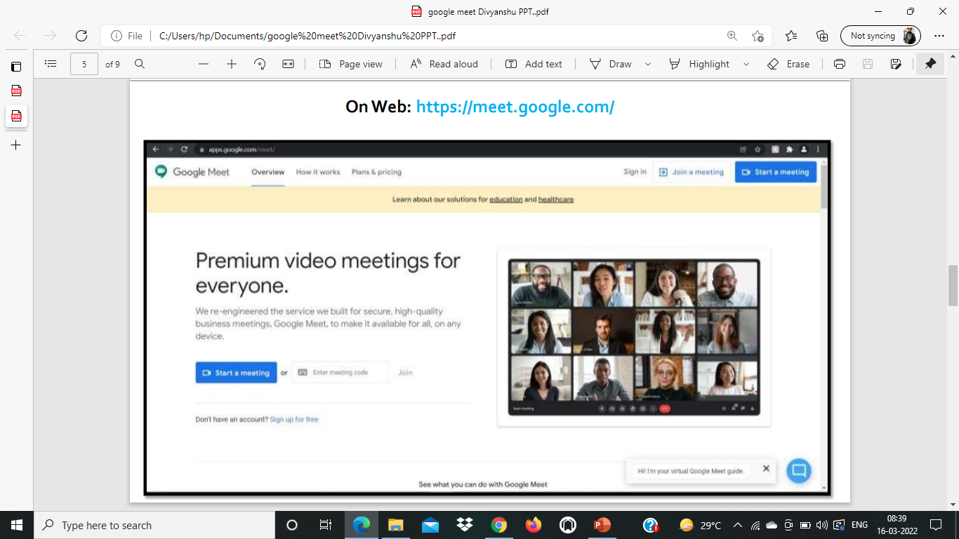
Meet’s features

Slide 6
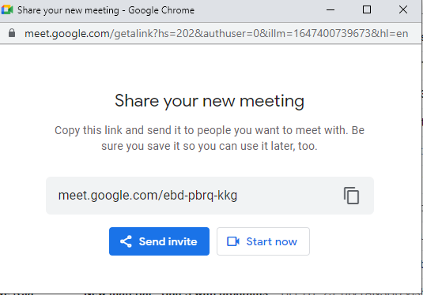
Meet’s features
Send a link or meeting code to anyone you want to join the meeting. For the free version of Google Meet, guests will need to create or sign in to an existing Google Account to join

Slide 7
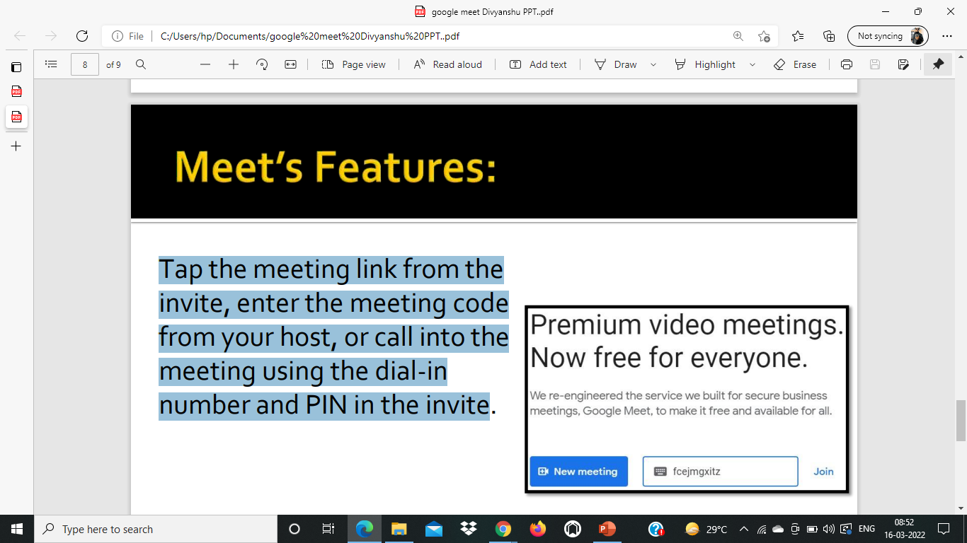
Meet’s features
Tap the meeting link from the invite, enter the meeting code from your host, or call into the meeting using the dial-in number and PIN in the invite

Slide 8
By- RUMIT RAVAL_FYIT_69
THANK YOU !!

